Slide 1
Chapter 12
Wireless Networking

Slide 2
Cellular Technology
Global System Mobile – GSM
SIM Chip holding all the information abut the subscriber
Subject to cloning
AT&T an T-Mobile
Code Division Multiple Access – CDMA
Uses a unique code for each call and spreads the data across the spectrum
Sprint and Verizon
Notes:
GSM: cell phone that contains a SIM card, allows you to move your SIM card from phone-to-phone
Used multiplexing which allowed multiple users to communicate to one tower over the single set of frequencies
CDMA: everyone communicates at the same time using a specific code, codes were used to filter each call on the receiving end

Slide 3
Wireless Technology
802.11 Standard from IEEE
802.11a – 5GHz
802.11b – 2.4GHz
802.11g – 2.4GHz
802.11n – 2.4GHz/5GHz
802.11ac – 5GHz
802.11ax – 2.4GHz/5GHz
Notes:
802.11ax: Uses both 2.4 and 5 GHz
Enables more than 35% speed burst
Reduces overhead and latency

Slide 4
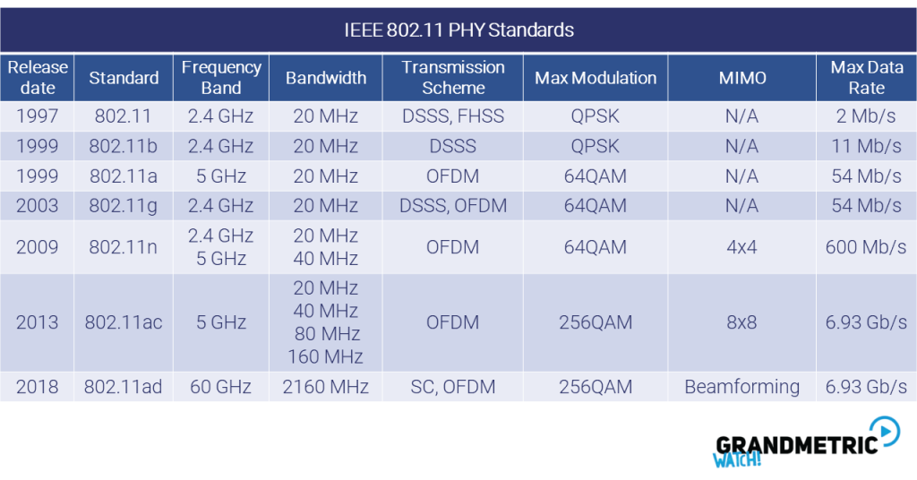
Notes:
Pay attention to the frequencies, data speeds

Slide 5
Wireless Terminology
Wireless Access Point (WAP)
Wireless Network Interface Card (WNIC)
Independent Basic Service Set (IBSS) – Ad Hoc Network
Basic Service Set
Wireless Controller/Wireless Distribution System(WDS)
Mobile Hot Spot

Slide 6
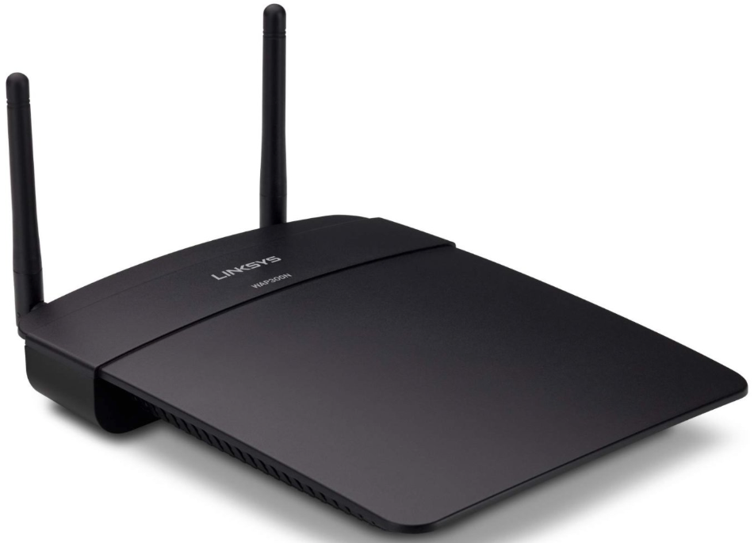
Wireless Access Points
Wireless networks have a component connecting all wireless devices together, the device is known as a wireless access point (WAP), or just AP.
Wireless access points have at least one antenna (sometimes two for better reception—called diversity) and a port to connect them to a wired network.
Antenna
Omni-Directional-Point to multi-point
Directional (Yagi)- Point to point
Notes:
Connects all wireless devices together
Can operate as a repeater, switch, or router depending on how its implemented
Has at least one antenna
Antennas act as both transmitters and receivers
Talk about the difference with the antenna directions
Directional antennas usually provide greater range than Omni-directional
The MAC address for the AP is called a BSSID: Basic Service Set Identifier

Slide 7
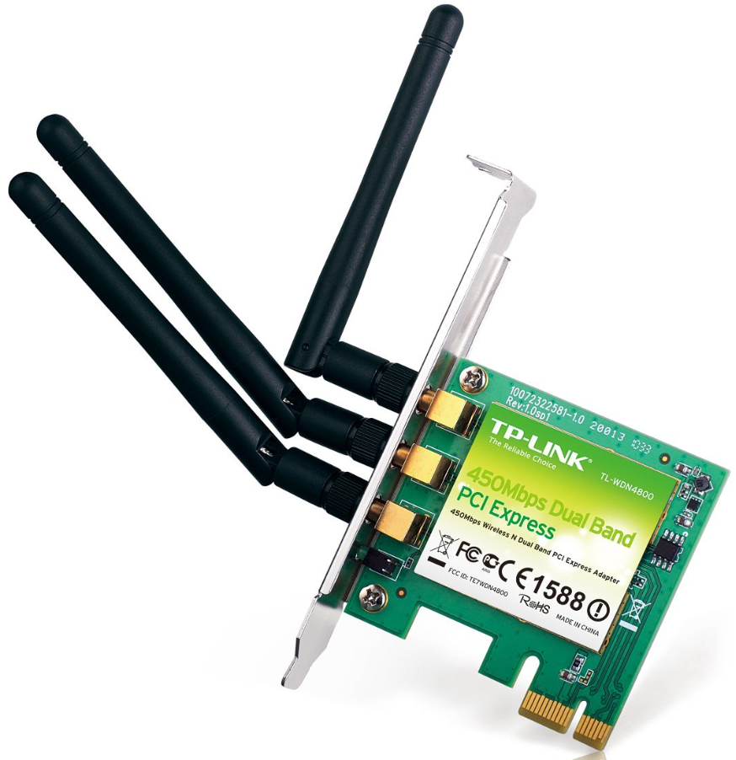
Wireless Network Interface Card (Wireless NIC)
A wireless NIC does the same job as a traditional NIC; but instead of having a socket to plug some cable into, the wireless NIC has a radio antenna.
Notes:
Does the same job as a traditional NIC, but it has a radio antenna

Slide 8



Wireless Networks
Ad-Hoc Mode: Independent Basic Service Set (IBSS)
In ad-hoc mode, the wireless devices communicate directly WITHOUT the need for an access point.
An example of this is two laptops with wireless NICs installed. If both cards were set up to operate in ad-hoc mode, they could connect and transfer files as long as the other network settings, like protocols, were set up to enable this as well.
This is an independent basic service set (IBSS)
Notes:
In this mode, the wireless NICs can communicate directly using 802.11 WITHOUT an AP
All you need is two wireless NICs and two computers
Bring the computers within 90-100m of each other
Cannot scale out well and is not recommended

Slide 9




Wireless Networks
Internet
DS*
Access point
Wireless clients
Infrastructure Mode: Basic Service Set (BSS)
Notes:
NICs communicate only with an AP instead of directly w/ each other
All comms go through the AP
Wireless clients appear to the rest of the network as it would on a standard wired host

Slide 10

Wireless Networks
Infrastructure Mode: Extended Service Set (ESS)
“Wireless Cell”
“Wireless Cell”
Channel 1
Channel 6
LAN Backbone
Overlapping
20%
SSID Sales
SSID Sales
Wireless clients
Wireless clients
Notes:
Set multiple access points to the same SSID and mobile wireless clients can roam around freely within the same network.
This creates an Extended Service Set ( ESS)) and provides more coverage then a single access point.
For users to be able to roam throughout the wireless network from AP to AP without losing their connection to the network, all APs must overlap by at least 10% of their signal.

Slide 11
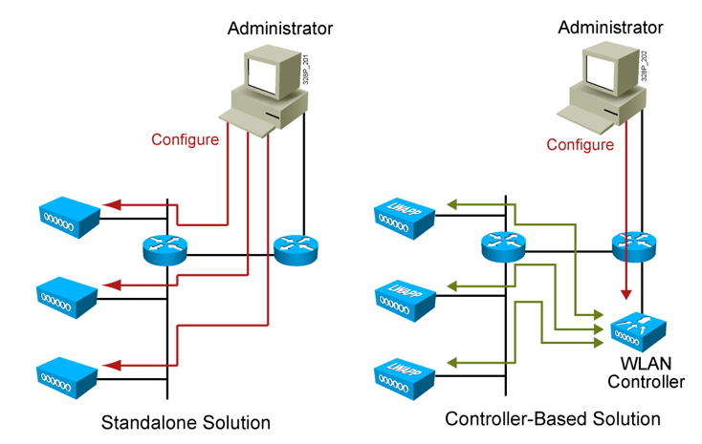
Standalone and controller-based
Notes:
In a stand alone solution, all the APs have a full OS loaded, running, and each must be managed separately
In the controller-based system, the APs do not have a full OS running on them
The controller and AP split duties; can be called thin APs
When an AP has a full OS it is referred to as a thick AP

Slide 12
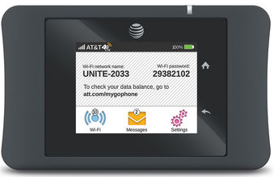
Figure 12.15 Mobile Hotspot
Notes:
Can connect your laptop, tablet, media devices, or any gaming device to the Internet at decent speeds
You can also use your phone as a mobile hotspot

Slide 13
Internet of Things (IOT)
What is IOT
Bluetooth
BlueJacking
BlueSnarfing
Near Field Communication (NFC)
Infrared (IR)
Notes:
Refrigerators, alarm systems, thermostats, etc
BlueJacking: transmits data to the target device
BlueSnarfing: high jacking Bluetooth signals to steal information
NFC: tap to pay
IR: Tv remote

Slide 14
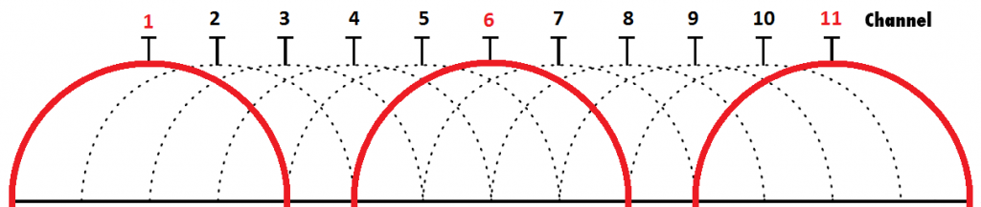
Implementing WIFI
Placement
Channels
Free channels are 1, 6, 11
Password
WEP
WPA
WPA2
Notes:
Try to use non-overlapping channels to decrease interference and latency
Different encryption tools to secure your network
WEP had extreme vulnerabilities so don’t ever use it
WPA came after and was ended to be a temporary fix until a new successor was created
WPA2 uses CCMP Block Cipher Mode; provides data confidentiality with AES encryption
WPA3 uses GCMP Block Cipher Mode; stronger encryption than WPA2

Slide 15
Wireless Security
Rogue Aps
Denial of Service (DOS)
War Driving
War Chalking
Notes:
Rogue APs: AP’s that connect to your wired infrastructure without your knowledge
Wardriving: involves attackers searching for wireless networks with vulnerabilities while moving around an area in a moving vehicle
Warchalking: is the drawing of symbols in public places to advertise an open Wi-Fi network

